Slide 1
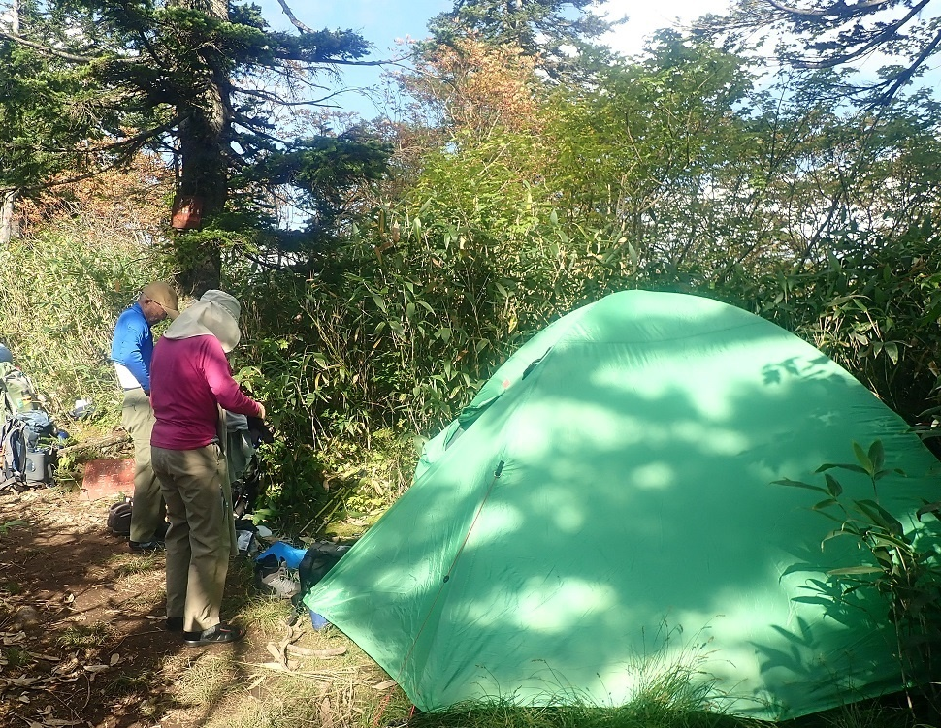
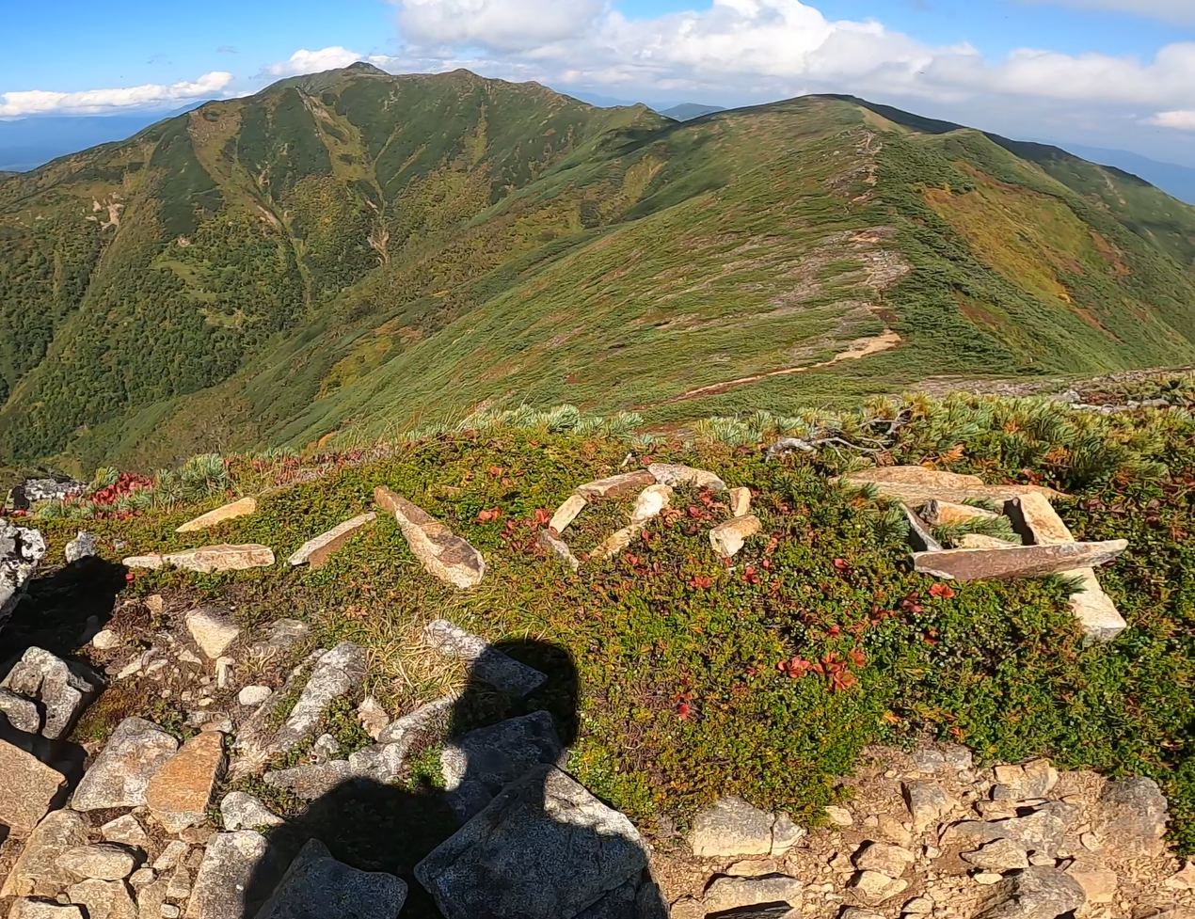
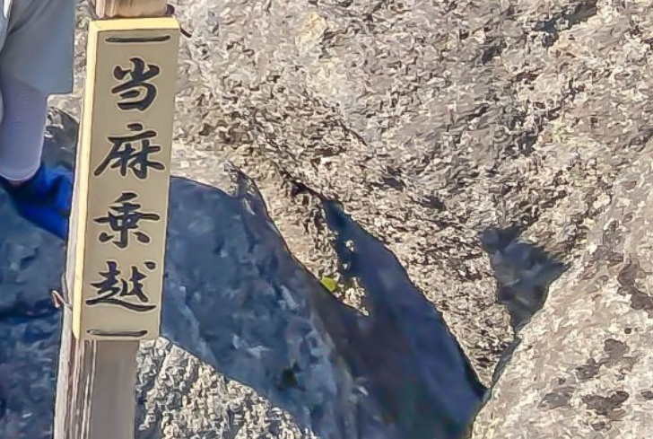
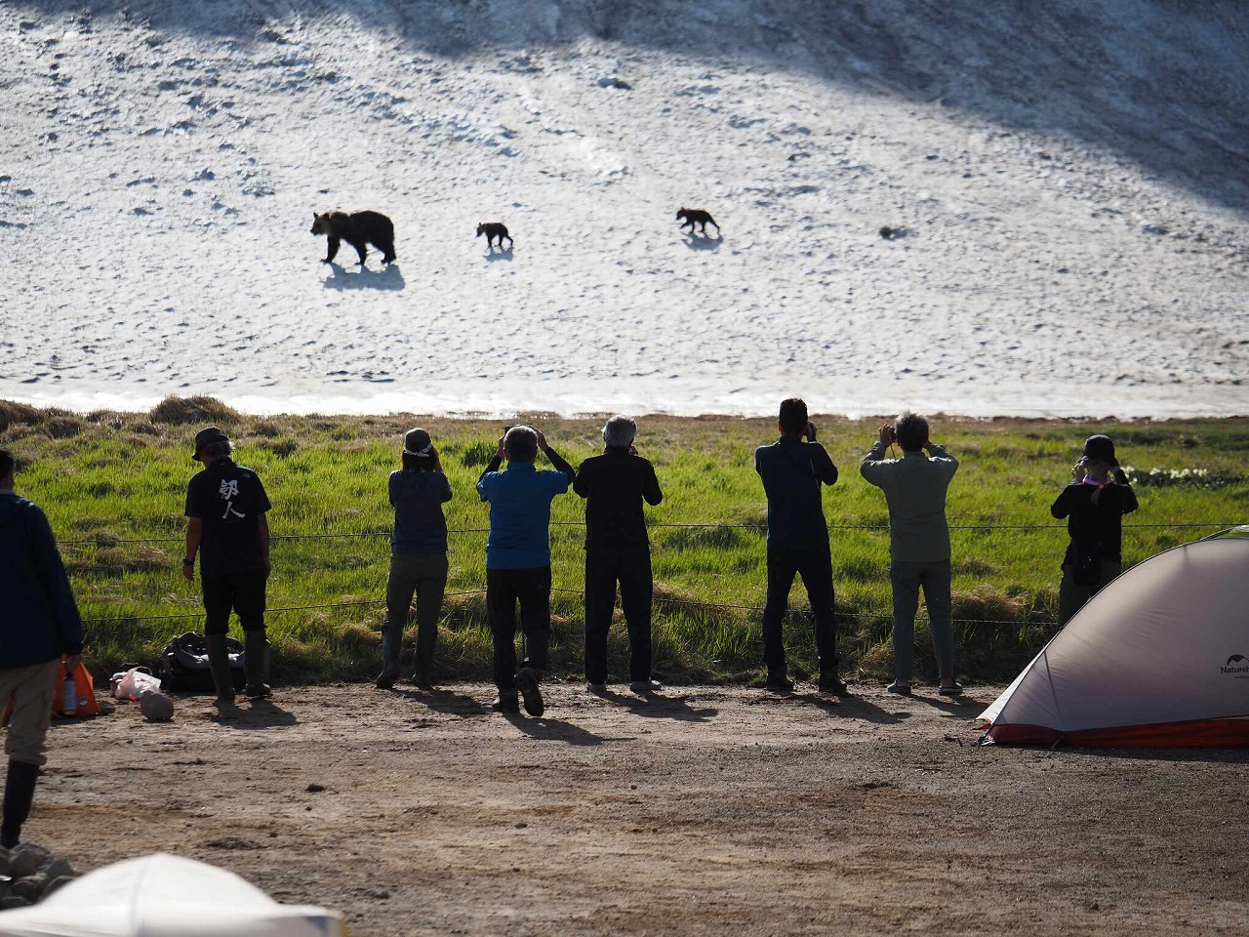
【Attention】
Regulations on conduct in national parks under the Natural Parks Act
Many of the mountainous areas with pristine natural scenery in Daisetsuzan National Park are designated as “Special Protection Zones” under the Natural Parks Act, which is strictly regulated.
Hence, various activities are regulated*.
●Capture, collection, or damage of wild animals and plants
Capturing or killing animals (including insects) or collecting or damaging plants (including fallen leaves) is prohibited.
●Installation of structures
No structures, including tents, may be set up outside of the designated camping sites.
Bonfires are prohibited in all areas, including designated camping areas.
●Collecting earth and stones and changing the shape of the land
It is prohibited to collect earth and stones or moving stones (such as, creating letters with placed stones or to build cairns and other activities).
●Installation of advertisements
No advertising materials or signs can be brought onto the site, and no graffiti may be placed on the rocks or stones.
●To feed, approach, or to follow wild animals
Feeding, leaving food, garbage, abruptly approaching, or following wild animals is prohibited.
<Examples of restrictions on activities in “Special Protection Zones”>
Camping outside of designated areas
Damage to vegetation caused by stones affected by humans
Signs installed without a permit
Park users approaching brown bears
Several problematic activities have recently been identified and reported in the “Special Protection Zones”. Please be aware that these activities without permission are punishable by law.
Please be very careful not to engage in these activities without permission.
*For inquiries regarding the Natural Parks Act, please contact the Ministry of the Environment Daisetsuzan National Park Management Office (01658-2-2574).

